Slide 1
Macronutrients

Slide 2
Objectives
Identify the function(s) of macronutrients
Differentiate between monosaccharides and disaccharides
Compare and contrast phospholipids, sterols, and triglycerides
List the essential and non-essential amino acids
Calculate the calories in food by applying the fuel values for carbohydrates, protein, and fat
Describe the changes to the nutrition facts panel by 2018

Slide 3
Nutrients function to provide energy, promote growth & development and regulate body processes
Provide energy | Promote growth & development | Regulate body processes

Slide 4
Macronutrients: fuel values
Carbohydrates
Lipids
Protein
Alcohol
Notes:
The macronutrients provide energy to maintain body functions during rest and all forms of physical activity

Slide 5
Carbohydrates
Monosaccharides
Disaccharides
Oligosaccharides
Polysaccharides

Slide 6
Monosaccharides

Slide 7
Glucose
Glucose

Slide 8
Fructose and galactose
Fructose
Galactose forms milk sugar called
Notes:
Fructose: sweetest of the simple sugars, found in fruit and honey
Galactose: does not occur freely in nature

Slide 9
Disaccharides
Combining two monosaccharide molecules forms a disaccharide
Sucrose = Glucose + Fructose
Lactose = Glucose + Galactose
Maltose = Glucose + Glucose
Notes:
Sucrose: the most common dietary disaccharide, occurs naturally in most foods that contain carbohydrates, refined to make table sugar
Lactose: found in natural form only in milk; lactose intolerance: lack enzyme to breakdown lactose
Maltose: occurs in beer, cereals, and germinating seeds, also known as malt sugar

Slide 10
Plant polysaccharides
Starch and fiber: 2 common forms
Starch
Notes:
Starch can be found in seeds, corn, and various grains that make bread, cereal, spaghetti, and pastries.
Large amounts of starch can also be found in peas, beans, potatoes, and roots.
Starch exists in two forms: amylose, a long straight chain of glucose units twisted into a helical coil, and amylopectin, a highly branched monosaccharide linkage.

Slide 11
Polysaccharides
Fiber
Two types
Water-soluble:
Water-insoluble:
Notes:
Found only in plants: makes up the structure of leaves, stems, roots, seeds, and fruit coverings.
Water-soluble fibers help to lower cholesterol levels, water-insoluble fibers do not.

Slide 12
Glycogen
Glycogen
Glycogenolysis
Notes:
Each gram of glycogen or glucose provides 4 kCal of energy.

Slide 13
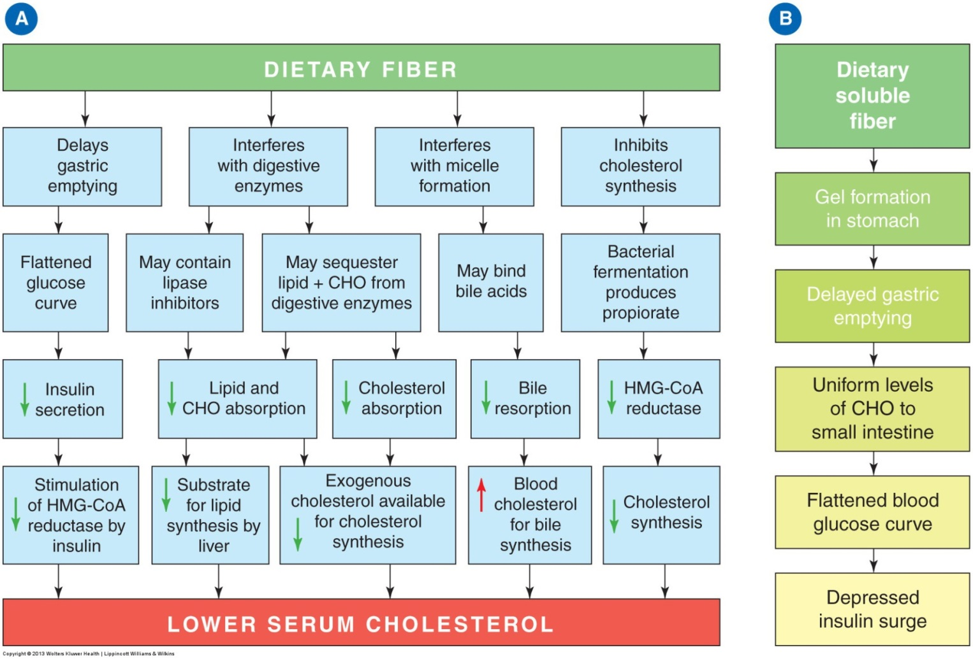
Notes:
Possible mechanism by which dietary fiber lowers blood cholesterol.
Possible mechanisms by which dietary soluble fiber lowers blood glucose.

Slide 14
Benefits of fiber
Retains water and provides “bulk” to the food residues in the intestines

Slide 15
Regulation of blood glucose levels
Hormones help to regulate blood sugar levels
Insulin
Glucagon
Notes:
Insulin: secreted by beta cells in the pancreas, helps to lower blood sugar levels.
Glucagon: secreted by alpha cells in the pancreas, helps to raise blood sugar levels, insulin antagonist.

Slide 16
Hypoglycemia

Slide 17
Lipids
Notes:
Lipids are composed of carbon, hydrogen, and oxygen.
98% of dietary lipids are triacylglycerols.

Slide 18
Lipids include triglycerides, phospholipids, and sterols
Triglycerides: most common type of lipid in food (about 95%)
Phospholipids: component of cell membranes
Sterols: a type of steroid (ex: cholesterol)
L
I
P
I
D
S

Slide 19
Triglycerides
Notes:
Most fatty acids range from 16–18 carbons.
Glycerol and fatty acids are joined through condensation.
Lipase enzymes breakdown lipids during hydrolysis

Slide 20
Fatty acids
Saturated fatty acids
Unsaturated fatty acids
Notes:
Saturated fats are found primarily in animal products (beef, lamb, pork, chicken, egg yolks, and dairy products).
Hydrogenation changes oils to semisolid compounds.

Slide 21
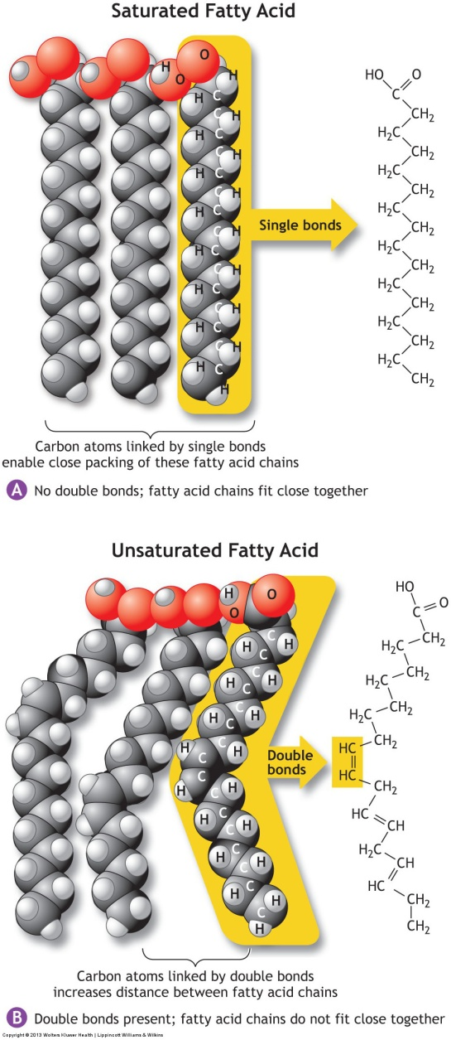

Slide 22
Essential fatty acids
Fatty acids that the body cannot synthesize:
Notes:
Fatty acids are needed for components of body structures; for the functioning of the immune system; and for vision, plasma membranes, and hormone production.

Slide 23
Protein
Formed from amino acids
Notes:
Dipeptide: 2 amino acids
Tripeptide: 3 amino acids
Polypeptide: up to 100 amino acids
Side chain makes amino acids unique.

Slide 24
Amino acids
The body requires ____ different amino acids

Slide 25
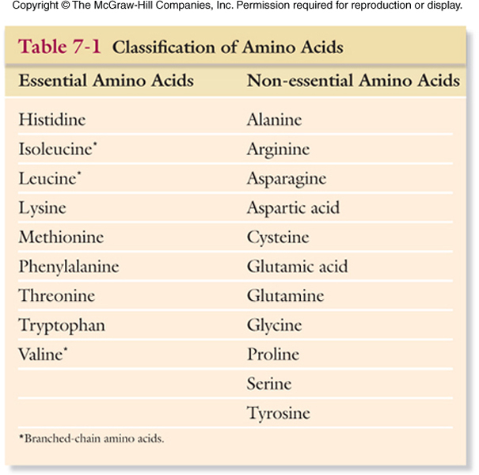

Slide 26
Complete vs. incomplete proteins
Complete proteins:
Incomplete proteins:

Slide 27
Understanding the nutrition facts Label

Slide 28
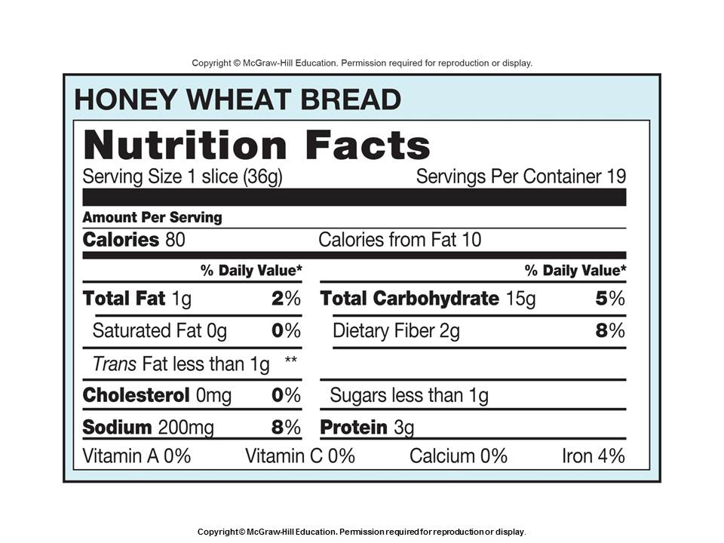

Slide 29
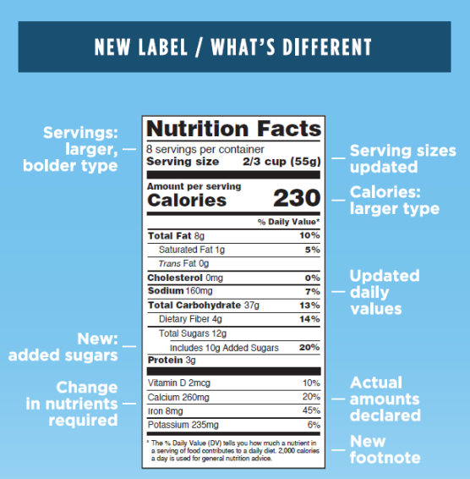
Changes to the nutrition label (by 2018)
Reference:http://www.fda.gov/Food/GuidanceRegulation/GuidanceDocumentsRegulatoryInformation/LabelingNutrition/ucm385663.htm

Slide 30
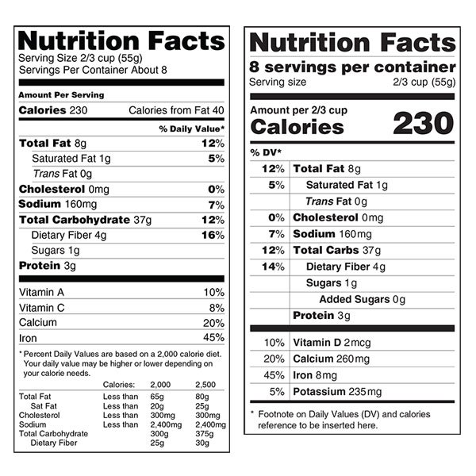
Current nutrition label vs. proposed nutrition label

Slide 31
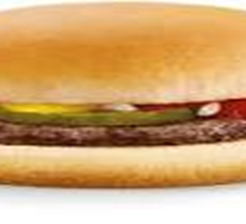
Practice problem
Calculate the amount of calories in a hamburger using the following information:
39 g carbohydrate
32 g fat
30 g protein

Slide 32
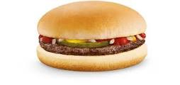
Practice problem: Answer

